Slide 1
Case Example:
Bayesian Adaptive, Dose-Finding, Seamless Phase 2/3 Study of a Long-Acting Glucagon-Like Peptide-1 Analog (Dulaglutide)
Date | Presenter

Slide 2
The views and opinions expressed in the following PowerPoint slides are those of the individual presenter and should not be attributed to Drug Information Association, Inc. (“DIA”), its directors, officers, employees, volunteers, members, DIA Communities or affiliates, or any organization with which the presenter is employed or affiliated.
These PowerPoint slides are the intellectual property of the individual presenter and are protected under the copyright laws of the United States of America and other countries. Used by permission. All rights reserved. Drug Information Association, DIA and DIA logo are registered trademarks or trademarks of Drug Information Association Inc. All other trademarks are the property of their respective owners.

Slide 3
Executive Summary/Abstract
Dulaglutide is a once-weekly glucagon-like peptide-1 analog for the treatment of T2DM. During its development, an adaptive, dose-finding, inferentially seamless phase 2/3 study (AWARD-5) was utilized to identify up to two doses (Low and High doses) at end of stage 1 that have a high probability of meeting criteria for safety and efficacy. The Bayesian algorithm allowed for an efficient exploration of a large number of doses and selected dulaglutide doses of 1.5 and 0.75mg at 26 weeks for further investigation in stage 2 of this study. Both dulaglutide doses demonstrated superior glycemic control versus sitagliptin at 52 weeks with an acceptable tolerability and safety profile.

Slide 4
Background
Dose selection for the dulaglutide clinical development program utilized an adaptive design within the first confirmatory dulaglutide trial (AWARD-5) that enabled exploration of 7 doses in a dose-finding portion, and possible selection of up to 2 doses. The primary and secondary objectives compared the efficacy and safety of selected dulaglutide doses and with placebo at 26 weeks, and with sitagliptin at 52 and 104 weeks.
Study is divided into 2 stages based on 2 randomization schemes:
  Stage 1: Bayesian adaptive scheme
  Stage 2: A fixed scheme

Slide 5
Background
Stage 1 employed an adaptive, dose-finding design to lead to a dula dose-selection decision or early study termination due to futility. Since dose selection occurred, study proceeded to stage 2 that allowed continued evaluation of the selected dula doses. The statistical inference for the selected doses at the end of the confirmatory phase used all data from the relevant treatment groups from both stages, with appropriate statistical methodology to avoid inflation of the Type I error rate. Although the adaptive algorithm employed Bayesian methods, the final analysis used frequentist methods. At completion, the entire study served as a confirmatory phase 3 trial.

Slide 6
Bayesian Justification
Dose selection is a pivotal milestone in drug development and has important implications for the ultimate usefulness of a drug. Lilly conducted a 52-week, 2 stage, adaptive, inferentially seamless phase 2/3 study in patients with type 2 diabetes mellitus as a pivotal trial in the clinical development of dulaglutide. One objective of the study is to identify up to 2 doses of dulaglutide (referred to as the high and low dose) to be continued into Stage 2 of this trial and used in all Phase 3 clinical trials to evaluate the safety and efficacy of dulaglutide.

Slide 7
Bayesian Justification
In place of a traditional Phase 2 dose-finding study, the initial stage of this trial employed a Bayesian adaptive dose-finding design to lead to a dulaglutide dose-selection decision. The adaptive design feature allowed for a broader range of dulaglutide doses evaluated, optimized patient treatment in the trial based on accumulating data, and enabled improved characterization of the dose-response relationship thereby leading to better selection of the dulaglutide doses carried forward into the Phase 3 trials.

Slide 8
Statistical Analysis Plan
In Stage 1, an adaptive treatment allocation was used to assign patients to the dula doses. The adaptations were based on a clinical utility index (CUI), a single metric that reflects 4 prespecified safety and efficacy response measures:
hemoglobin A1c (HbA1c); an established biomarker of glycemic control in patients with diabetes
Weight; weight loss is a potential safety benefit of GLP-1 analogs
Heart rate (HR)
Diastolic blood pressure (DBP).
Heart rate and diastolic blood pressure are expected to be the dose-limiting safety parameters for dulaglutide.

Slide 9
Statistical Analysis Plan
Dula decision rules are designed to select doses based on the likelihood of meeting 1 of 3 profiles. The HbA1c reduction observed with selected dula doses should be either noninferior or preferentially superior to that of sitagliptin at 12 months.
If the glycemic control of the doses selected is superior to that of sitagliptin, then weight neutrality is acceptable.
If the glycemic control of the doses selected is only noninferior to that of sitagliptin, then weight loss (at least 2.5 kg @ 6 months ) must be associated with the compound.
Alternatively, if the doses selected do not demonstrate superiority to sitagliptin and have no associated weight loss, then at least a mean 1.0% reduction in HbA1c (from baseline) is desired.

Slide 10
Statistical Analysis Plan
Irrespective of the effects on HbA1c and weight, the doses selected must be safe. Ideally the doses selected should have no clinically relevant impact on heart rate or blood pressure. The dula doses selected must not increase heart rate more than 5 bpm (change from baseline relative to placebo) or diastolic blood pressure (DBP) more than 2 mmHg (change from baseline relative to placebo).

Slide 11
Statistical Analysis Plan
After 200 patients have been randomized into Stage 1, each dula dose is evaluated to determine if it qualifies as the high or low dose. Both the high and low doses must meet one of the profiles.
When n=200-399, the algorithm will recommend the trial proceed into Stage 2 if both a high and a low dula dose meet the prespecified criteria or if only a high dula dose can be identified and continued searching for a low dose is deemed futile.

Slide 12
Statistical Analysis Plan
After 400 patients have enrolled in Stage 1, the probability thresholds that a dose meets the prespecified criteria will be lowered. If at this time a dose is not identified that meets the prespecified criteria, then the trial will stop and no Stage 2 will be conducted.
These decision rules maximize the opportunity to select 2 doses within the given constraints. However, if no low dose can be identified, study will proceed into Stage 2 and the other Phase 3 trials with only one dula dose.

Slide 13
Tools <Code>
<What software was used for analysis? If you wish to share code, create a new slide containing your code>

Slide 14
Efficacy Model
(Adaptive Allocation in Dose Selection Stage)c
There are 2 goals operationalized in the adaptive allocation scheme. The first is to find the maximum utility dose (MUD). The second is to find the minimally acceptable dose (MAD).
MUD Dose: dose that has the maximum utility based on the current information.
MAD Dose: lowest dose that has a utility of at least 0.60.
For each interim analysis, the posterior probability that each dose is the MUD (P_{MUD}(d)) and the posterior probability that each dose is the MAD (P_{MAD}(d)) are calculated.

Slide 15
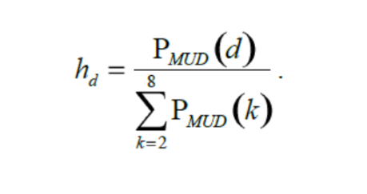
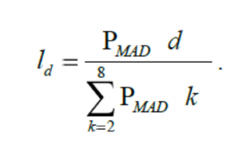
Efficacy Model
(Adaptive Allocation in Dose Selection Stage)c
These quantities are used to weigh the relative value of allocating to each dose for the goal of finding the MUD.
Let h_{d} be the randomization probability of allocating to dose d, for the goal of finding the MUD dose:
Let ld be the randomization probability of allocating to dose d, for the goal of finding the MAD dose:

Slide 16
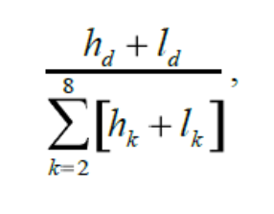
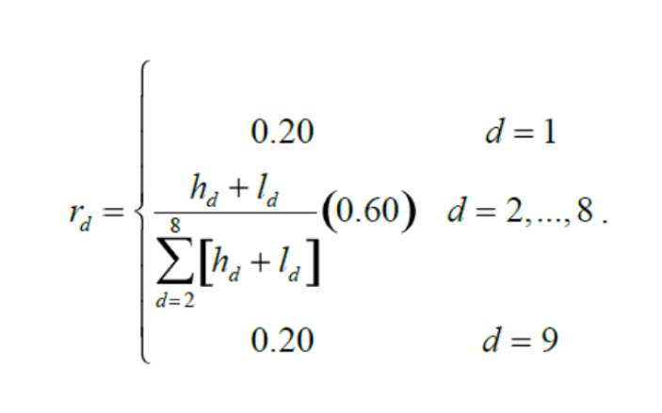
Efficacy Model
(Adaptive Allocation in Dose Selection Stage)c
These probabilities are combined together (equally weighted) to form the relative randomization probabilities for the dula compound:
We assume fixed probabilities for the placebo arm (r1) and the sitagliptin arm (r9). The adaptive randomization probabilities are:

Slide 17
Efficacy Model
(Adaptive Allocation in Dose Selection Stage)c
At each interim look after the sample size is at least 200, the decision to stop for futility, select dula doses, or continue in Stage 1 is assessed.
Stop for futility if at least 1 of the following holds for each active dose:
  PPNI(d) < 0.05 where PPNI(d) = The predictive probability of noninferiority to sitagliptin (= 0.4) at the end of Stage 2 if dose d is included in Stage 2.
  PrU(d) < 0.05 where PrU(d) = The probability that a dose has a utility of at least 0.60.

Slide 18
Efficacy Model
(Adaptive Allocation in Dose Selection Stage)c
Go to Stage 2 if 3 below holds and either a or b below holds, for the most likely MUD, labeled Max
    PPNI(Max) > 0.85 and PrU(Max)>0.60
      PrU(d) > 0.60 for some d, with dose level no greater than 0.50 of the Max dose. If multiple d‘s satisfy this condition then select the highest for the low dose.
      Every dose d with dose level no greater than 0.50 of the Max dose satisfies at least 1 condition that defines futility.
C. Otherwise, continue with Stage 1.

Slide 19
Efficacy Model
(Adaptive Allocation in Dose Selection Stage)c
When the sample size in Stage 1 reaches the maximum sample size of 400 (and condition A above does not hold), then go to Stage 2 if 1 of the following 2 holds:
PPNI(Max) > 0.80 and PrU(Max)>0.60 (the High dose is Max)
  If PrU(d) > 0.60 for some d, with dose level no greater than 0.50 of the selected High dose, then the highest of these doses d would be selected as the Low dose.

Slide 20
Efficacy Model
(Adaptive Allocation in Dose Selection Stage)c
PPNI(d) > 0.80 and PrU(d)>0.60 for any d=3,…, 8 (the highest dose that satisfies these conditions would be the High dose)
  If PrU(d) > 0.60 for some d, with dose level no greater than 0.50 of the selected High dose, then the highest of these doses d would be selected as the Low dose. Else continue with just the High dose.
If none of the above are true when the maximum sample size of 400 is reached then the trial stops at the 400 sample size and no Stage 2 is conducted.

Slide 21
Efficacy Result
Dulaglutide 1.5 mg was determined to be the optimal dose. Dulaglutide 0.75mg met criteria for the second dose. Dulaglutide 1.5 mg showed the greatest Bayesian mean change from baseline (95% credible interval) in HbA1c versus sitagliptin at 52weeks −0.63 (−0.98 to −0.20)%. Dulaglutide 2.0 mg showed the greatest placebo-adjusted mean change in weight [−1.99 (−2.88 to −1.20) kg] and in PR [0.78 (-2.10 to 3.80) bpm]. Dulaglutide 1.5 mg showed the greatest placebo-adjusted mean change in DBP [−0.62 (−3.40 to 2.30) mmHg].

Slide 22
Sensitivity Analyses
Trial simulation was used to demonstrate the operating characteristics of this design and compare efficiencies of the adaptive approach to that of a conventional fixed-dose design. A typical dose-finding Phase 2 fixed design trial was simulated as a reference design using analogous decision rules with the most likely scenario. In these simulations appropriate doses were selected approximately 6% of the time. Extending the length of time of the trial from 12 weeks to 26 weeks did not meaningfully improve these results. The low likelihood of selecting a dose is largely due to the failure to identify a dose that satisfies the strict heart rate and blood pressure criteria.
Notes:
Instruction: if other priors or approaches are considered, include them here

Slide 23
Conclusion
The Bayesian algorithm allowed for an efficient exploration of a large number of doses and selected dulaglutide doses of 1.5 and 0.75mg for further investigation in this trial.

